Slide 1

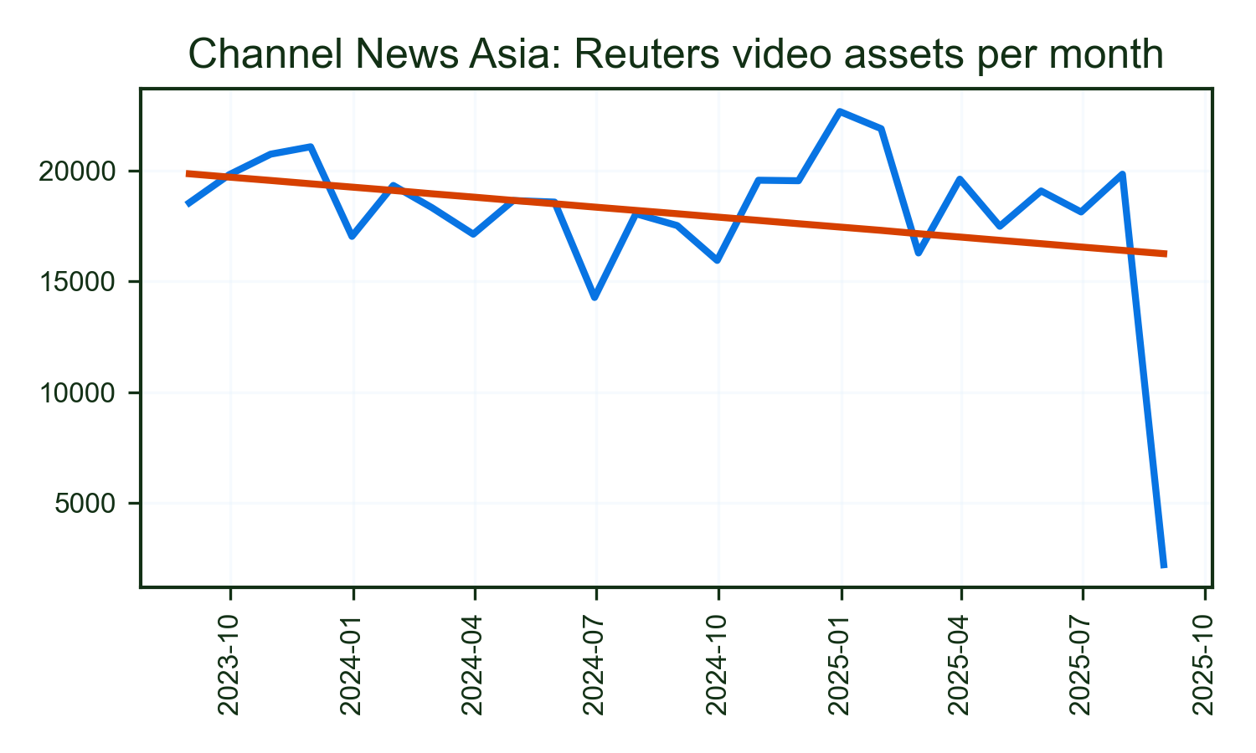
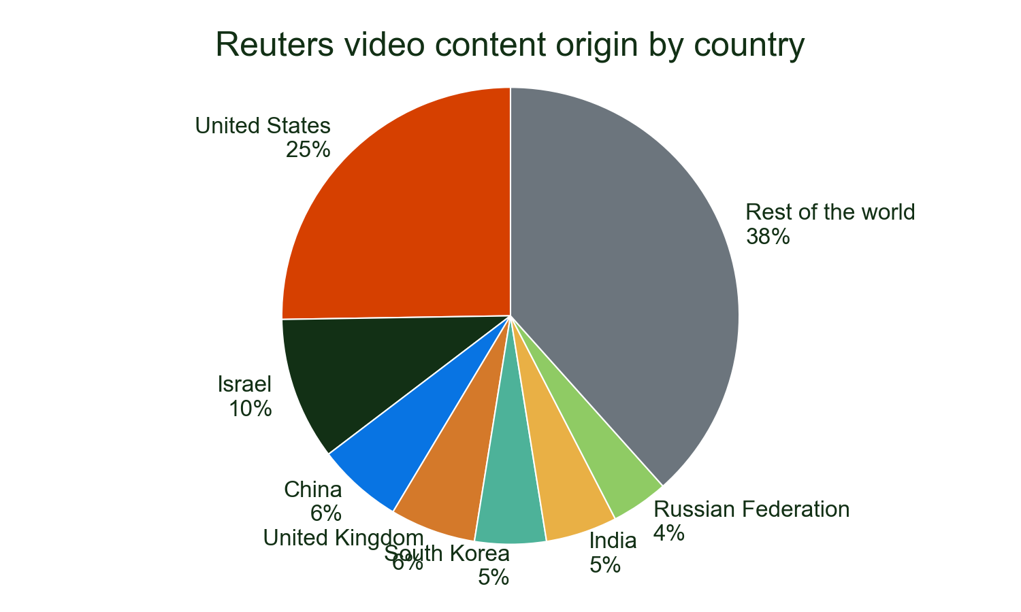
Channel News Asia's use of Reuters video progressed its gentle upwards trend in 2025, which has seen baseline usage gentle in the last 2 years.
It remains very reliant on Reuters video for coverage from the US and used nearly 451,121 video assets from 1 countries.
Major stories
• ISRAEL: 18.1%
• USA: 14.2%
• SOUTHKOREA: 5.4%
Of all detections of Reuters video on Channel News Asia in 2025.

